Slide 1

Curating the Exhibition
Automating Gallery Submissions for Blockly.games
By neil fraser & Luca hess
Notes:
Neil

Slide 2

Blockly.games
Notes:
Neil

Slide 3
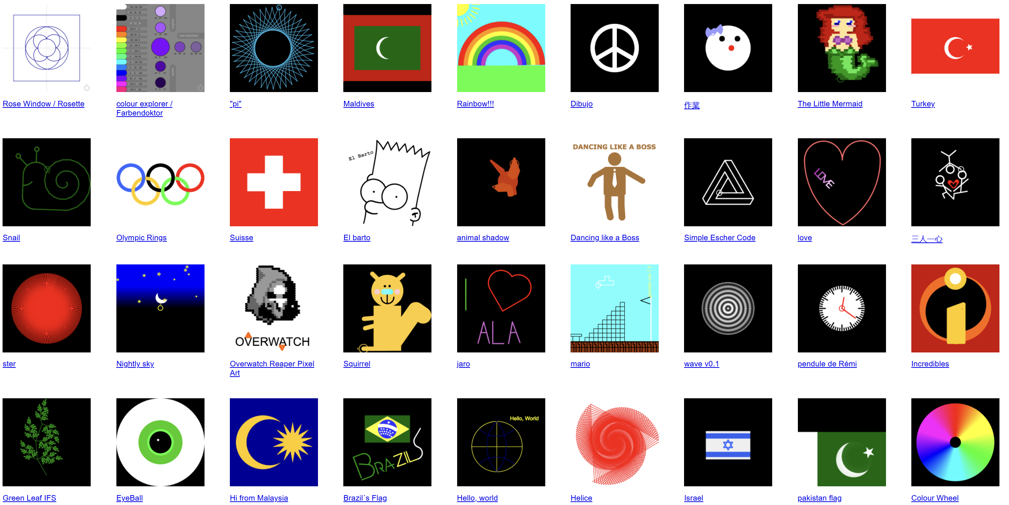
The Gallery
Notes:
Luca
Current queue: 161k images. Coming in faster than can be vetted.
Let neil go forward

Slide 4
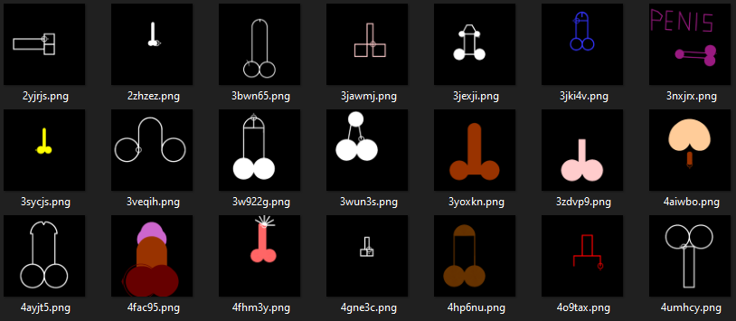
Problem #1
Notes:
Neil

Slide 5
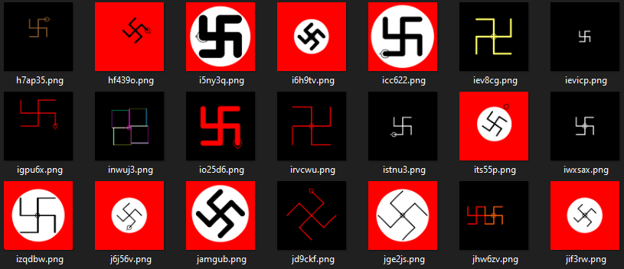
Problem #2
Notes:
neil

Slide 6
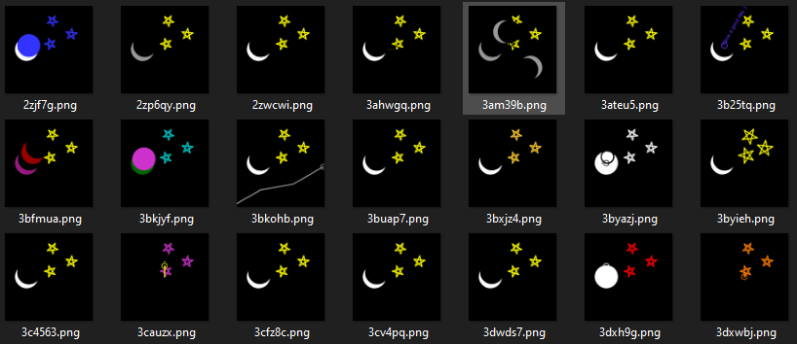
Problem #3
Notes:
neil

Slide 7


The Solution – Image similarity
Creating a pool of images we want new submissions to differ from
Comparing candidates to each pool-image one by one
If similarity is high → chuck it!
If similarity is low → keep it!
(What to publish is an unrelated question.)
Notes:
Luca

Slide 8

Data Augmentation - isotopes
But what is similarity?
Generating isotopes of original with quantified difference
Original
Notes:
Luca

Slide 9

Data Augmentation - isotopes
But what is similarity?
Generating isotopes of original with quantified difference
Isotope – 24%

Slide 10

Data Augmentation - isotopes
But what is similarity?
Generating isotopes of original with quantified difference
Original
Isotope – 24%
Notes:
Luca

Slide 11
Defining Loss
We define three loss conditions for training
Self-Self → Should be 100% similar
Self-Isotope → Similarity defined by mutations applied
Self-Other → Similarity should be low
Difference between expected and predicted similarity used to train.
Notes:
Luca

Slide 12
Models
Convolutional
Merge both images into one
Siamese ResNet18, 34, 50, 101 & 152
Robust CNN, various depths available
Siamese DINOv2
Visual Transformer, semantic image embedding
Notes:
Neil

Slide 13



Convolutional
Merge images into one. Train to compare similarity of left and right halves.
Expect: ~80%
Expect: ~0%
Notes:
Neil

Slide 14
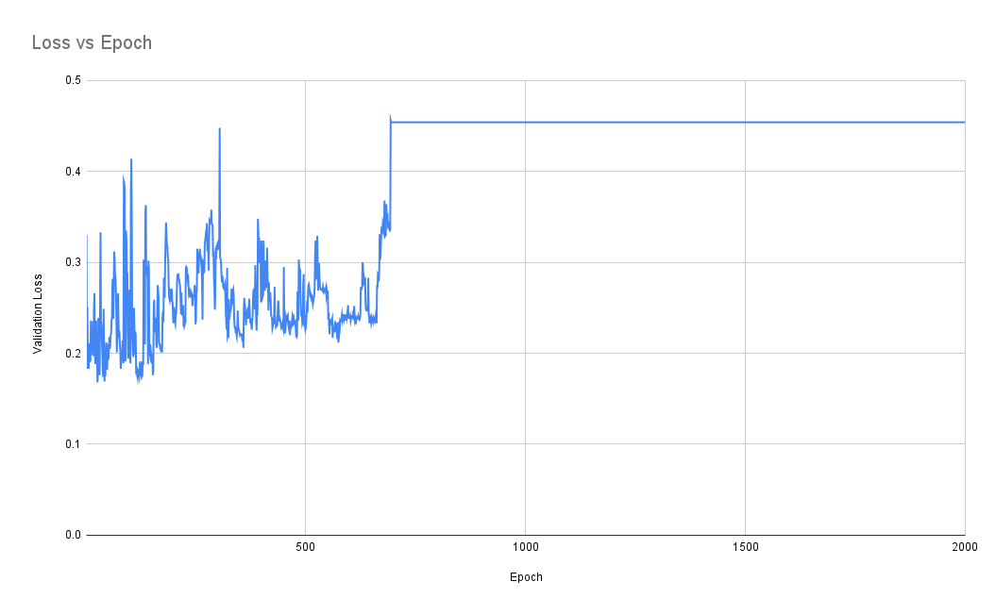
Convolutional (Fail)
Notes:
Neil
0.45

Slide 15

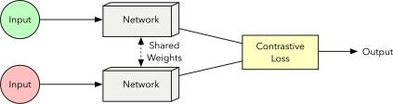
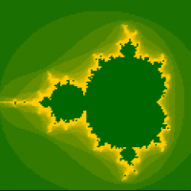
Siamese ResNet
Notes:
Neil

Slide 16
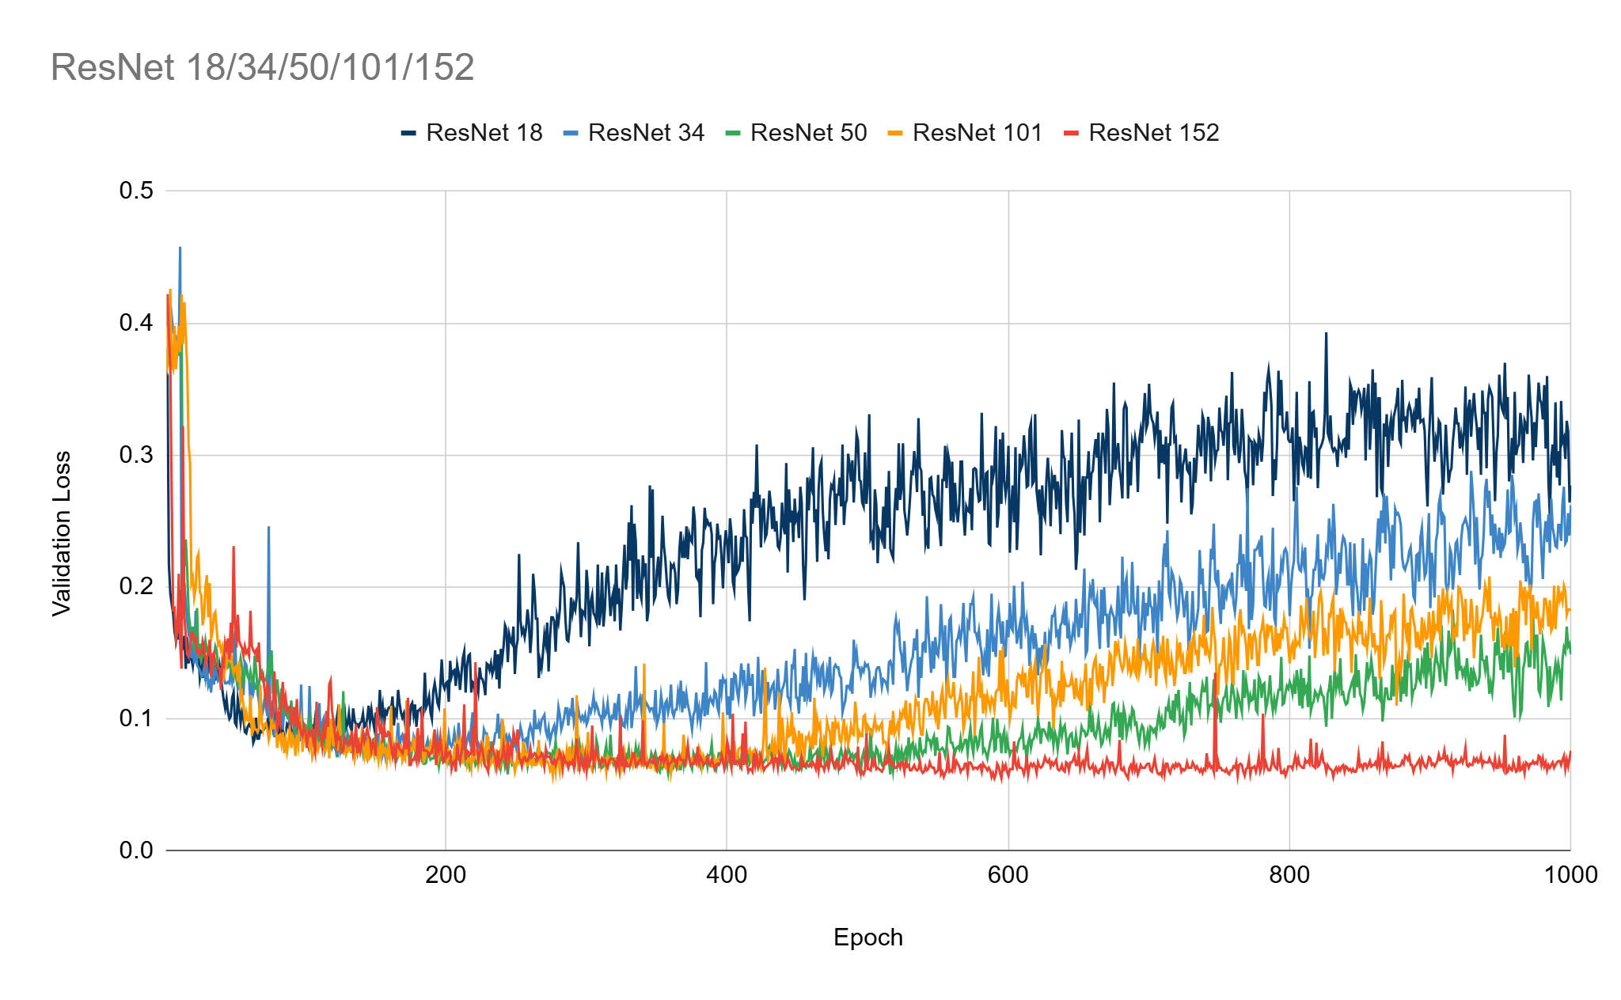
Siamese ResNet
Overfitting after ~150 epochs
Good performance
Notes:
Neil
5 different resnet models
95% accuracy

Slide 17



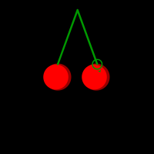
ResNet False Positives
95% match
94% match
Notes:
Neil

Slide 18
Siamese Dino
Embedding Vector 1
mean(Cosine Similarity – Target Similarity)^2
Embedding Vector 2
Notes:
Luca

Slide 19
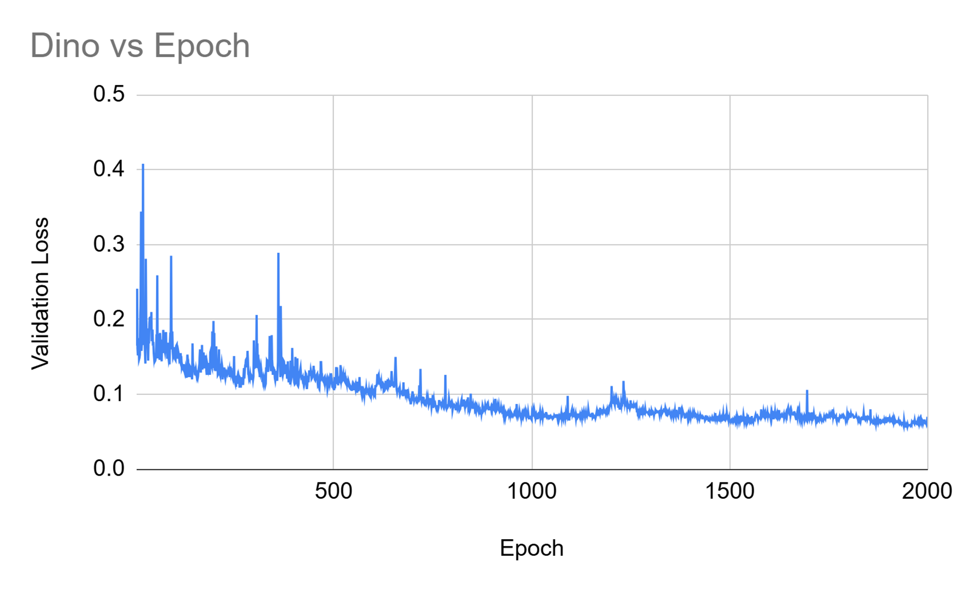
Siamese Dino
No overfitting within tested epoch range
Continuous improvement!
Good performance
330MB network
20 kWh of power
10 kg CO₂
Notes:
Luca

Slide 20




Dino False Positives
98% match
91% match
Notes:
Luca

Slide 21
Future Directions
Adaptive learning rate
Caching vectors
Levenstein's distance
Notes:
Neil

Slide 22

Thank You for your attention
Notes:
Luca

